Slide 1
CS 211 Computer Architecture Lecture 39: Virtual Memory - 1
Ravi Mittal
ravi.mittal@iitgoa.ac.in
Indian Institute of Technology, Goa

Slide 2
We will study today ..
Motivation for Virtual Memory
Physical Address, Virtual Address and Address Space
Address Translation
Address Translation and Virtual Memory Organization
Memory Protection
Summary

Slide 3
Reading for this lecture
Memory Organization
Chapter 8, Digital Design and Computer Architecture, Harris and Harris
Lecture 25b: Virtual Memory, Prof Onur Mutulu, ETH Zurich, https://safari.ethz.ch/digitaltechnik/spring2018/doku.php?id=schedule
Chapter 6, Memory Hierarchy, Book: Computer Systems: A programmer’s perspective, Randal E. Bryant and David R. O’Hallaron

Slide 4
Memory Organization: What we have studied so far

Slide 5
Recall: Memory Locality
A “typical” program has a lot of locality in memory references
typical programs are composed of “loops”
Temporal: A program tends to reference the same memory location many times and all within a small window of time
Spatial: A program tends to reference a cluster of memory locations at a time
most notable examples:
Instruction memory references
Array/data structure references

Slide 6
Example Memory Hierarchy
L0:
Regs
CPU registers hold words retrieved from the L1 cache.
Smaller,
faster,
and
costlier
(per byte)
storage
devices
L1:
L1 cache
(SRAM)
L1 cache holds cache lines retrieved from the L2 cache.
L2:
L2 cache
(SRAM)
L2 cache holds cache lines
retrieved from L3 cache.
L3:
L3 cache
(SRAM)
L3 cache holds cache lines
retrieved from main memory.
Larger,
slower,
and
cheaper
(per byte)
storage
devices
L4:
Main memory
(DRAM)
Main memory holds disk blocks retrieved from local disks.
L5:
Local secondary storage
(local disks)
Local disks hold files retrieved from disks
on remote servers.
L6:
Remote secondary storage
(e.g., Web servers)

Slide 7
Recall: Caches
Cache: A smaller, faster storage device that acts as a staging area for a subset of the data in a larger, slower device.
Fundamental idea of a memory hierarchy:
For each k, the faster, smaller device at level k serves as a cache for the larger, slower device at level k+1.
Why do memory hierarchies work?
Because of locality, programs tend to access the data at level k more often than they access the data at level k+1.
Thus, the storage at level k+1 can be slower, and thus larger and cheaper per bit.
Big Idea (Ideal): The memory hierarchy creates a large pool of storage that costs as much as the cheap storage near the bottom, but that serves data to programs at the rate of the fast storage near the top.
Bryant and O’Hallaron, Computer Systems: A Programmer’s Perspective, Third Edition

Slide 8
Recall: General Cache Concepts
Smaller, faster, more expensive
memory caches a subset of
the blocks
Cache
8
4
9
14
10
3
Data is copied in block-sized transfer units
4
10
Larger, slower, cheaper memory
viewed as partitioned into “blocks”
Memory
0
1
2
3
4
4
5
6
7
8
9
10
10
11
12
13
14
15
Bryant and O’Hallaron, Computer Systems: A Programmer’s Perspective, Third Edition

Slide 9
General Cache Organization (S, E, B)
E = 2e lines per set
set
line
S = 2^{s} sets
Cache size
= S x E x B data bytes
v
tag
0
1
2
B-1
valid bit
B = 2^{b} bytes per cache block (the data)
Bryant and O’Hallaron, Computer Systems: A Programmer’s Perspective, Third Edition

Slide 10
N-Way Set Associative Cache

Slide 11

What is Virtualization?

Slide 12
Virtual World
Virtual Memory
Virtual Machine
Virtual LAN
Virtual Private Network
Server Virtualization
Link Virtualization
Platform Virtualization
Resource Virtualization
Virtual Desktop

Slide 13
Virtualization ?
Virtualization is the process of creating software based or virtual, representation of something
Virtual Applications
Servers
Storage
Networks
The abstraction of computer resources
Virtualization is the process of creating a software-based, or virtual, representation of something, such as virtual applications, servers, storage and networks.
The access request for the resource is intercepted and different view of the resource is presented

Slide 14
So far we looked at Cache and MM… How to make it virtual and why?

Slide 15
A System Using Physical Addressing
Physical (Main) memory
0:
1:
Physical address
(PA)
2:
CPU
3:
4
4:
5:
6:
7:
8:
...
M-1:
Data word
Used in “simple” systems like embedded microcontrollers in devices like cars, elevators, and digital picture frames
This is not the way most systems work: Desktop, Mobile etc
Notes:
The main memory of a computer system is organized as an array of M contiguous byte-size cells. Each byte has a unique physical address (PA).

Slide 16
A System with Physical Memory Only
Examples:
Most Cray machines
Early PCs
Nearly all embedded systems
CPU’s load or store addresses used
directly to access memory
Memory
0:
Physical
Addresses
1:
CPU
N-1:
Notes:
Potential Problem?

Slide 17
How about when we run multiple programs (processes)?

Slide 18
Multiprogramming
OS runs multiple applications simultaneously
Strictly one process at a time but context switch
OS switches between processes very quickly
Context switching
Deciding what process to run is called scheduling
Programs can be scheduled in a variety of ways!

Slide 19
User mode: multiple applications
Process A
Process B
RAM
CPU

Slide 20
User mode: multiple applications
Process A
Process B
RAM
CPU

Slide 21
User mode: multiple applications
Process A
Process B
Process A
RAM
CPU

Slide 22
User mode: multiple applications
SWITCH
Process A
Process B
Process A
RAM
CPU

Slide 23
User mode: multiple applications
Process A
Process B
Wait… that shouldn’t happen!
Process A
RAM
Process B
CPU

Slide 24
User mode: multiple applications
Process A
Process B
Please give me Process A’s data! I am evil!
Process A
RAM
Process B
CPU

Slide 25
User mode: multiple applications
Process A
Process B
Process A
RAM
Process C
Process B
CPU
Process C

Slide 26
User mode: multiple applications
Process A
Process A
RAM
Process C
Process D
Process D
CPU
Hmm… There’s enough space, but not all together!
Process C

Slide 27
User mode: multiple applications
Process A
Process A
RAM
Process C
Process C
Process D
CPU
Process D
There we go!

Slide 28
User mode: multiple applications
Process A
Process A
RAM
Process C
Wait… This isn’t my data?
Process C
Process D
CPU
Process D

Slide 29
Protection Required
Application could overwrite another application’s memory
Applications may want to address more memory than that is available in MM
Solution: Virtual Memory. Give each process the illusion of a full memory address space that it has completely to itself

Slide 30
Virtual: The Illusion!
Process A
RAM
I am the ONLY PROCESS accessing memory, and I don’t have to share it with anyone!
CPU

Slide 31
Physical: The Reality!
DISK
Process A
Process B
Process A
RAM
Process C
CPU
Process B
Process C

Slide 32
Memory Hierarchy
Upper Level
Regs
Faster
Instr Operands
L1 Cache
Earlier: Caches
Blocks
L2 Cache
Blocks
Now:
Virtual Memory
Memory
Pages
Disk
Files
Larger
Tape
Lower Level

Slide 33
“Bare” 5-Stage Pipeline
PC
Physical Address
D
E
M
Physical Address
W
Inst. Cache
Decode
Data Cache
+
Memory Controller
Physical Address
Physical Address
Physical Address
Main Memory (DRAM)
In a bare machine, the only kind of address is a physical address

Slide 34
Virtual address and Physical Address
Logical Address
PC
D
Decode
E
M
W
Inst. Cache
Data Cache
+
Physical Address
Physical Address
Physical Address
Physical Address
Memory Controller
Physical Address
Main Memory (DRAM)

Slide 35
Address Spaces
Linear address space: Ordered set of contiguous non-negative integer addresses: {0, 1, 2, 3 … }
Virtual address space: Set of N = 2^{n} virtual addresses {0, 1, 2, 3, …, N-1}
N-bit address space: a virtual address space with N = 2^{n} addresses
Modern systems typically support either 32-bit or 64-bit virtual address spaces.
Physical address space: Set of M = 2^{m} physical addresses {0, 1, 2, 3, …, M-1}
Notes:
Virtual Address Space is usually much larger than Physical Address Space
Physical Address space is that of DRAM – the main memory.
Virtual address space is the same for all processes.

Slide 36
Why Virtual Memory?
When you execute a program, do you bother about main memory?
Don’t you assume that all the memory is for your program?
Do you even know what location in Main Memory your program resides?
Do you also know if the full program resides in the Main Memory?
What is your view about the addresses used in your program or process?
BTW, you know that a process is an instance of executing program

Slide 37
Why Virtual Memory (VM)?
Uses main memory efficiently
Use DRAM as a cache for parts of a virtual address space
Simplifies memory management
Each process gets the same uniform linear address space
Isolates address spaces
One process can’t interfere with another’s memory
User program cannot access privileged kernel information and code

Slide 38
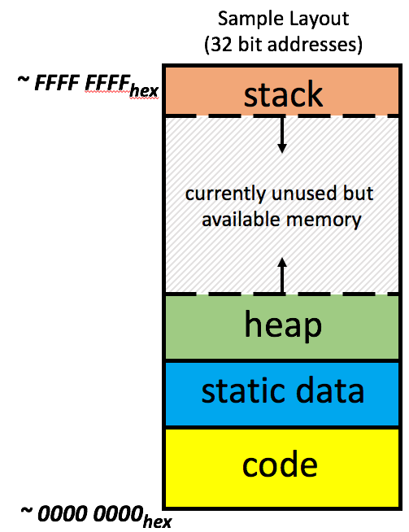
Each process has it’s own (virtual) address space
Process 1
Process 2
Process n

Slide 39
Address Space, Virtual Address, Physical Address

Slide 40
Address Spaces
Virtual address space: Set of N = 2^{n} virtual addresses {0, 1, 2, 3, …, N-1}
Set of addresses that the user program knows about
N-bit address space: a virtual address space with N = 2^{n} addresses
Modern systems typically support either 32-bit or 64-bit virtual address spaces.
Physical address space: Set of M = 2^{m} physical addresses {0, 1, 2, 3, …, M-1}
Set of addresses that map to actual physical locations in memory
Hidden from user applications
Notes:
Virtual Address Space is usually much larger than Physical Address Space
Physical Address space is that of DRAM – the main memory.
Virtual address space is the same for all processes.

Slide 41
Virtual vs. Physical Addresses
Memory manager
Processor (& Caches)
?
Memory (DRAM)
Control
Datapath
Virtual Address
PC
Physical Address
Bytes
Registers
(ALU)
Many of these (software & hardware cores)
One main memory
Each Process uses it’s own address space
Processes use virtual addresses, e.g., 0 … 0xffff,ffff
Many processes, all using same (conflicting) addresses
Memory uses physical addresses (also, e.g., 0 ... 0xffff,ffff)
Memory manager maps virtual to physical addresses
Ref: Krste Asanović & Randy H. Katz, Univ of California, Berkeley

Slide 42
VM as a tool for caching

Slide 43
VM as a Tool for Caching
Conceptually, virtual memory is an array of N contiguous bytes stored on disk. Virtual Memory (on disk) has pages.
Pages are bigger (say 4KB) thank Blocks (typically 64 bytes)
The contents of the array on disk are cached in physical memory (DRAM cache)
These cache blocks are called pages (size is P = 2^{p} bytes)
Virtual memory
Physical memory
VP 0
Unallocated
0
VP 1
Cached
0
Empty
PP 0
Uncached
PP 1
Unallocated
Empty
Cached
Uncached
Empty
Cached
M-1
PP 2^{m-p}-1
VP 2^{n-p}-1
Uncached
N-1
Virtual pages (VPs)
stored on disk
Physical pages (PPs)
cached in DRAM
Notes:
Virtual Pages are numbered VP0, VP1, … VP 2^{n-p} - 1

Slide 44
Note
At any point in time, the set of virtual pages is partitioned into three disjoint subsets:
Unallocated: Pages that have not yet been allocated (or created) by the VM system. Unallocated blocks do not have any data associated with them, and thus do not occupy any space on disk.
Cached: Allocated pages that are currently cached in physical memory.
Uncached: Allocated pages that are not cached in physical memory.

Slide 45
DRAM Cache Organization
DRAM cache organization driven by the enormous miss penalty
DRAM is about 10x slower than SRAM
Disk is about 10,000x slower than DRAM
Time to load block from disk > 1ms (> 1 million clock cycles)
CPU can do a lot of computation during that time
Consequences
Large page (block) size: typically 4 KB
Linux “huge pages” are 2 MB (default) to 1 GB
Fully associative
Any VP can be placed in any PP
Requires a “large” mapping function – different from cache memories
Highly sophisticated, expensive replacement algorithms
Too complicated and open-ended to be implemented in hardware
Write-back rather than write-through

Slide 46
Enabling Data Structure: Page Table
A page table is an array of page table entries (PTEs) that maps virtual pages to physical pages.
Per-process kernel data structure in DRAM
Physical memory
(DRAM)
Physical page
number or
disk address
Valid
VP 1
PP 0
PTE 0
0
null
VP 2
1
VP 7
VP 4
PP 3
1
0
1
0
null
Virtual memory
(disk)
0
PTE 7
1
VP 1
Memory resident
page table
(DRAM)
VP 2
VP 3
VP 4
VP 6
VP 7

Slide 47
Note
Each page in the virtual address space has a PTE at a fixed offset in the page table
Each PTE consists of a valid bit and an n-bit address field
The valid bit indicates whether the virtual page is currently cached in DRAM
If the valid bit is set, the address field indicates the start of the corresponding physical page in DRAM where the virtual page is cached
Valid bit is not set:
Null address indicates that the virtual page has not been allocated
Non-null address points to the start of virtual page on disk
Any physical page can contain any virtual page (fully associative)

Slide 48
Page Hit
Page hit: reference to VM word that is in physical memory (DRAM cache hit)
Physical memory
(DRAM)
Physical page
number or
disk address
Virtual address
Valid
VP 1
PP 0
PTE 0
0
null
VP 2
1
VP 7
VP 4
PP 3
1
0
1
0
null
Virtual memory
(disk)
0
PTE 7
1
VP 1
Memory resident
page table
(DRAM)
VP 2
VP 3
VP 4
VP 6
VP 7

Slide 49
Page Fault
Page fault: reference to VM word that is not in physical memory (DRAM cache miss)
Physical memory
(DRAM)
Physical page
number or
disk address
Virtual address
Valid
VP 1
PP 0
PTE 0
0
null
VP 2
1
VP 7
VP 4
PP 3
1
0
1
0
null
Virtual memory
(disk)
0
PTE 7
1
VP 1
Memory resident
page table
(DRAM)
VP 2
VP 3
VP 4
VP 6
VP 7

Slide 50
Triggering a Page Fault
User writes to memory location
That portion (page) of user’s memory is currently on disk
MMU triggers page fault exception
Raise privilege level to supervisor mode
Causes procedure call to software page fault handler
80483b7: c7 05 10 9d 04 08 0d movl $0xd,0x8049d10
int a[1000];
main ()
{
a[500] = 13;
}
User code
Kernel code
Exception: page fault
movl
Execute page fault handler

Slide 51
Handling Page Fault
Page miss causes page fault (an exception)
Physical memory
(DRAM)
Physical page
number or
disk address
Virtual address
Valid
VP 1
PP 0
PTE 0
0
null
VP 2
1
VP 7
VP 4
PP 3
1
0
1
0
null
Virtual memory
(disk)
0
PTE 7
1
VP 1
Memory resident
page table
(DRAM)
VP 2
VP 3
VP 4
VP 6
VP 7

Slide 52
Handling Page Fault
Page miss causes page fault (an exception)
Page fault handler selects a victim to be evicted (here VP 4)
Physical memory
(DRAM)
Physical page
number or
disk address
Virtual address
Valid
VP 1
PP 0
PTE 0
0
null
VP 2
1
VP 7
VP 3
PP 3
1
1
0
0
null
Virtual memory
(disk)
0
PTE 7
1
VP 1
Memory resident
page table
(DRAM)
VP 2
VP 3
VP 4
VP 6
VP 7

Slide 53
Handling Page Fault
Page miss causes page fault (an exception)
Page fault handler selects a victim to be evicted (here VP 4)
Offending instruction is restarted: page hit!
Physical memory
(DRAM)
Physical page
number or
disk address
Virtual address
Valid
VP 1
PP 0
PTE 0
0
null
VP 2
1
VP 7
VP 3
PP 3
1
1
0
0
null
Virtual memory
(disk)
0
PTE 7
1
VP 1
Memory resident
page table
(DRAM)
VP 2
VP 3
Key point: Waiting until the miss to copy the page to DRAM is known as demand paging
VP 4
VP 6
VP 7

Slide 54
Completing page fault
int a[1000];
main ()
{
a[500] = 13;
}
Page fault handler executes return
Return to instruction that caused fault
But, this time there is no page fault
80483b7: c7 05 10 9d 04 08 0d movl $0xd,0x8049d10
User code
Kernel code
Exception: page fault
movl
Copy page from disk to memory
Return and reexecute movl

Slide 55
Terminology
Pages (= same as blocks)
Swapping or Paging
The activity of transferring a page between disk and memory
Paging
The strategy of waiting until the last moment to swap in a page, when a miss occurs
all modern systems use demand paging.
Other approaches try to predict misses and swap pages in before they are actually referenced

Slide 56
Allocating Pages
Allocating a new page (VP 5) of virtual memory
May be as a result of malloc
Subsequent miss will bring it into memory
Physical memory
(DRAM)
Physical page
number or
disk address
Valid
VP 1
PP 0
PTE 0
0
null
VP 2
1
VP 7
VP 3
PP 3
1
1
0
0
Virtual memory
(disk)
0
PTE 7
1
VP 1
Memory resident
page table
(DRAM)
VP 2
VP 3
VP 4
VP 5
VP 6
VP 7

Slide 57
Locality to the Rescue Again!
Virtual memory works because of locality
At any point in time, programs tend to access a set of active virtual pages called the working set
Programs with better temporal locality will have smaller working sets
If (working set size < main memory size)
Good performance for one process (after cold misses)
If (working set size > main memory size )
Thrashing: Performance meltdown where pages are swapped (copied) in and out continuously
If multiple processes run at the same time, thrashing occurs if their total working set size > main memory size

Slide 58
Lecture Summary
Programmer’s view of virtual memory
Each process has its own private linear address space
Cannot be corrupted by other processes
System view of virtual memory
Uses memory efficiently by caching virtual memory pages
Efficient only because of locality

Slide 59
Backup

Slide 60
The Problem
Physical memory is of limited size (cost)
What if you need more?
Should the programmer be concerned about the size of code/data blocks fitting physical memory?
Should the programmer manage data movement from disk to physical memory?
Should the programmer ensure two processes (different programs) do not use the same physical memory?
Also, ISA can have an address space greater than the physical memory size
E.g., a 64-bit address space with byte addressability
What if you do not have enough physical memory?

Slide 61
Difficulties of Direct Physical Addressing
Programmer needs to manage physical memory space
Inconvenient and hard
Harder when you have multiple processes
Difficult to support code and data relocation
Addresses are directly specified in the program
Difficult to support multiple processes
Protection and isolation between multiple processes
Sharing of physical memory space
Difficult to support data/code sharing across processes

Slide 62
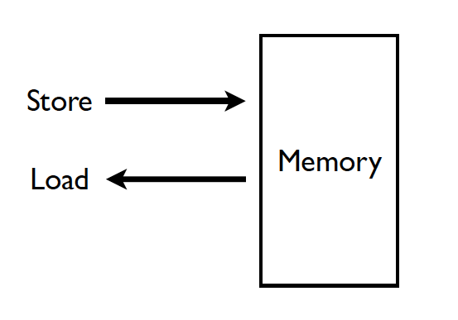
What does a programmer need ?

Slide 63
Ideal Memory
Zero access time (latency)
Infinite capacity
Zero cost
Infinite bandwidth (to support multiple accesses in parallel)

Slide 64
Virtual Memory
Idea: Give the programmer the illusion of a large address space while having a small physical memory
So that the programmer does not worry about managing physical memory
We will use the term physical memory to refer to main memory
Programmer can assume he/she has “infinite” amount of physical memory
Hardware and software cooperatively and automatically manage the physical memory space to provide the illusion
Illusion is maintained for each independent process

Slide 65
Abstraction: Virtual vs. Physical Memory
Programmer sees virtual memory
Can assume the memory is “infinite”
Reality: Physical memory size is much smaller than what the programmer assumes
The system (system software + hardware, cooperatively) maps virtual memory addresses to physical memory
The system automatically manages the physical memory space transparently to the programmer
+ Programmer does not need to know the physical size of memory nor manage it → A small physical memory can appear as a huge one to the programmer → Life is easier for the programmer
-- More complex system software and architecture

Slide 66
Basic Mechanism
Indirection (in addressing)
Address generated by each instruction in a program is a “virtual address”
i.e., it is not the physical address used to address main memory
called “linear address” in x86
An “address translation” mechanism maps this address to a “physical address”
called “real address” in x86
Address translation mechanism can be implemented in hardware and software together

Slide 67
Physical Address, Virtual Address Address Space

Slide 68
A System Using Physical Addressing
Physical (Main) memory
0:
1:
Physical address
(PA)
2:
CPU
3:
4
4:
5:
6:
7:
8:
...
M-1:
Data word
Used in “simple” systems like embedded microcontrollers in devices like cars, elevators, and digital picture frames
Notes:
The main memory of a computer system is organized as an array of M contiguous byte-size cells. Each byte has a unique physical address (PA).

Slide 69
Address Spaces
Linear address space: Ordered set of contiguous non-negative integer addresses: {0, 1, 2, 3 … }
Virtual address space: Set of N = 2^{n} virtual addresses {0, 1, 2, 3, …, N-1}
N-bit address space: a virtual address space with N = 2^{n} addresses
Modern systems typically support either 32-bit or 64-bit virtual address spaces.
Physical address space: Set of M = 2^{m} physical addresses {0, 1, 2, 3, …, M-1}

Slide 70
Address Translation Virtual Memory Organization

Slide 71
A System with Virtual Memory (Page based)
Main Memory
Address Translation: The hardware converts virtual addresses into physical addresses via an OS-managed lookup table (page table)
0:
Page Table
1:
Virtual
Addresses
Physical
Addresses
0:
1:
CPU
P-1:
N-1:
Disk

Slide 72
Virtual Pages, Physical Frames
Virtual address space divided into pages
Physical address space divided into frames
A virtual page is mapped to
A physical frame, if the page is in physical memory
A location in disk, otherwise
If an accessed virtual page is not in memory, but on disk
Virtual memory system brings the page into a physical frame and adjusts the mapping → this is called demand paging
Page table is the table that stores the mapping of virtual pages to physical frames

Slide 73
Physical Memory as a Cache
In other words…
Physical memory is a cache for pages stored on disk
In fact, it is a fully associative cache in modern systems (a virtual page can potentially be mapped to any physical frame)
Most accesses hit in the physical memory at the speed of DRAM, yet the program enjoys the capacity of the larger virtual memory
Similar caching issues exist as we have covered earlier:
Placement: where and how to place/find a page in cache?
Replacement: what page to remove to make room in cache?
Granularity of management: large, small, uniform pages?
Write policy: what do we do about writes? Write back?

Slide 74
Cache/Virtual Memory Analogues
Cache | Virtual Memory
Block | Page
Block Size | Page Size
Block Offset | Page Offset
Miss | Page Fault
Tag | Virtual Page Number

Slide 75
Virtual Memory Definitions
Page size: amount of memory transferred from hard disk to DRAM at once
Address translation: determining the physical address from the virtual address
Page table: lookup table used to translate virtual addresses to physical addresses (and find where the associated data is)

Slide 76
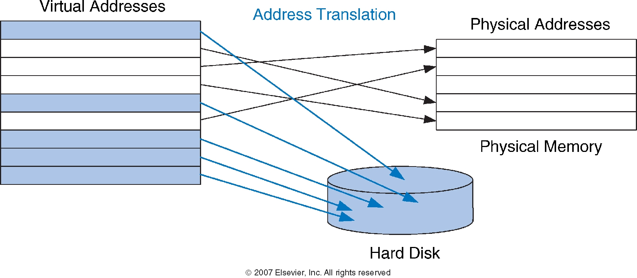
Virtual and Physical Addresses
Most accesses hit in physical memory
But programs see the large capacity of virtual memory

Slide 77
Virtual Memory Example
System:
Virtual memory size: 2 GB = 2³¹ bytes
Physical memory size: 128 MB = 2²⁷ bytes
Page size: 4 KB = 2¹² bytes

Slide 78
Virtual Memory Example
System:
Virtual memory size: 2 GB = 2³¹ bytes
Physical memory size: 128 MB = 2²⁷ bytes
Page size: 4 KB = 2¹² bytes
Organization:
Virtual address: 31 bits
Physical address: 27 bits
Page offset: 12 bits
# Virtual pages = 2³¹/2¹² = 2¹⁹ (VPN = 19 bits)
# Physical pages = 2²⁷/2¹² = 2¹⁵ (PPN = 15 bits)

Slide 79
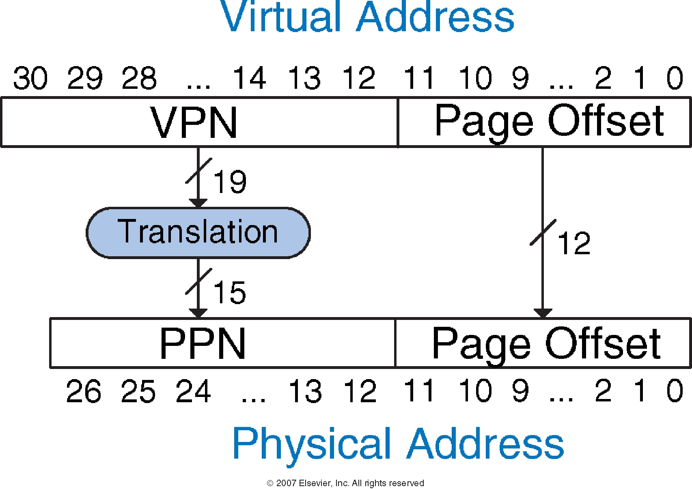
Address Translation

Slide 80
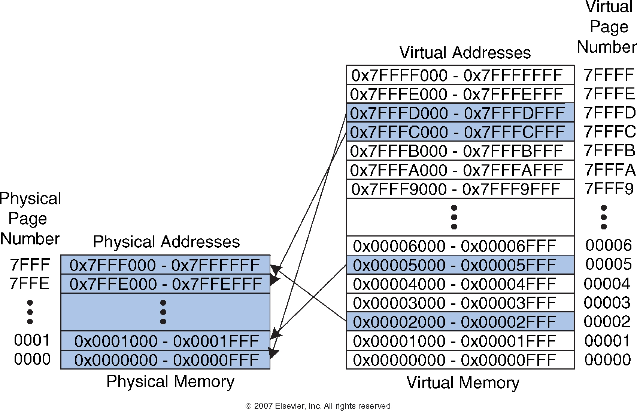
Virtual Memory Example

Slide 81
How Do We Translate Addresses?
Page table
Has entry for each virtual page
Each page table entry has:
Valid bit: whether the virtual page is located in physical memory (if not, it must be fetched from the hard disk)
Physical page number: where the page is located
Dirty bits: Replacement policy

Slide 82
Page Table Example

Slide 83
Page Table Example 1
What is the physical address of virtual address 0x5F20?

Slide 84
Page Table Example 1
What is the physical address of virtual address 0x5F20?
Note: number of bits in VA: 8
Virtual Page number: 05
Entry 5 in page table indicates VPN 5 is in physical page 1
Physical address is 0x1F20

Slide 85
Page Table Example 2
What is the physical address of virtual address 0x73E0?

Slide 86
Page Table Example 2
What is the physical address of virtual address 0x73E0?
VPN = 7
Entry 7 in page table is invalid, so the page is not in physical memory
The virtual page must be swapped into physical memory from disk
86

Slide 87
Issue: Page Table Size
64-bit
Suppose 64-bit VA and 40-bit PA, how large is the page table?
2⁵² entries x ~4 bytes ≈ 2⁵⁴ bytes
that is for just one process!
the process may not be using the entire VM space!
VPN
Page Offset
52-bit
12-bit
page
table
concat
PA
28-bit
40-bit

Slide 88
Page Table Challenges
Page table is large
at least part of it needs to be located in physical memory
Each load/store requires at least two memory accesses:
1. one for translation (page table read)
2. one to access data with the physical address (after translation)
Two memory accesses to service a load/store greatly degrades load/store execution time

Slide 89
Translation Lookaside Buffer (TLB)
Page table accesses have great temporal locality
Idea: Cache the page table entries (PTEs) in a hardware structure in the processor
Translation lookaside buffer (TLB)
Small cache of most recently used translations (Page table entries)
Significantly reduces number of memory accesses required for most loads/stores to only one

Slide 90
Translation Lookaside Buffer (TLB)
Page table accesses have a lot of temporal locality
Data accesses have temporal and spatial locality
Large page size (say 4KB, 8KB, or even 1-2GB), so consecutive loads/stores likely to access same page
TLB
Small: accessed in < 1 cycle
Typically 16 - 512 entries
High associativity
> 99 % hit rates typical (depends on workload)
Reduces # of memory accesses for most loads and stores to only 1

Slide 91
Example Two-Entry TLB

Slide 92
Memory Protection

Slide 93
Memory Protection
Multiple programs (processes) run at once
Each process has its own page table
Each process can use entire virtual address space without worrying about where other programs are
A process can only access physical pages mapped in its page table – cannot overwrite memory of another process
Provides protection and isolation between processes
Enables access control mechanisms per page

Slide 94
Virtual Memory Summary
Virtual memory gives the illusion of “infinite” capacity
A subset of virtual pages are located in physical memory
A page table maps virtual pages to physical pages – this is called address translation
A TLB speeds up address translation
Using different page tables for different programs provides memory protection

Slide 95
Backup

Slide 96
Supporting Virtual Memory
Virtual memory requires both HW+SW support
Page Table is in memory
Can be cached in special hardware structures called Translation Lookaside Buffers (TLBs)
The hardware component is called the MMU (memory management unit)
Includes Page Table Base Register(s), TLBs, page walkers
It is the job of the software to leverage the MMU to
Populate page tables, decide what to replace in physical memory
Change the Page Table Register on context switch (to use the running thread’s page table)
Handle page faults and ensure correct mapping

Slide 97
Some System Software Jobs for VM
Keeping track of which physical frames are free
Allocating free physical frames to virtual pages
Page replacement policy
When no physical frame is free, what should be swapped out?
Sharing pages between processes
Copy-on-write optimization
Page-flip optimization

Slide 98
Page Fault (“A Miss in Physical Memory”)
If a page is not in physical memory but disk
Page table entry indicates virtual page not in memory
Access to such a page triggers a page fault exception
OS trap handler invoked to move data from disk into memory
Other processes can continue executing
OS has full control over placement
Before fault
After fault
Memory
Memory
Page Table
Virtual
Addresses
Physical
Addresses
Page Table
Virtual
Addresses
Physical
Addresses
CPU
CPU
Disk
Disk

Slide 99
Servicing a Page Fault
(1) Processor signals controller
Read block of length P starting at disk address X and store starting at memory address Y
(2) Read occurs
Direct Memory Access (DMA)
Under control of I/O controller
(3) Controller signals completion
Interrupt processor
OS resumes suspended process
(1) Initiate Block Read
Processor
Reg
(3) Read Done
Cache
Memory-I/O bus
(2) DMA Transfer
I/O
controller
Memory
Disk
Disk

Slide 100
Page Table is Per Process
Each process has its own virtual address space
Full address space for each program
Simplifies memory allocation, sharing, linking and loading.
0
Physical Address
Space (DRAM)
Virtual Address Space for Process 1:
0
Address Translation
VP 1
PP 2
VP 2
...
N-1
(e.g., read/only library code)
PP 7
Virtual Address Space for Process 2:
0
VP 1
VP 2
PP 10
...
N-1
M-1

Slide 101
Address Translation
Parameters
P = 2^{p} = page size (bytes).
N = 2^{n} = Virtual-address limit
M = 2^{m} = Physical-address limit
n–1
p
p–1
0
virtual page number
page offset
virtual address
address translation
m–1
p
p–1
0
physical frame number
page offset
physical address
Page offset bits don’t change as a result of translation

Slide 102
Address Translation (IV)
Separate (set of) page table(s) per process
VPN forms index into page table (points to a page table entry)
Page Table Entry (PTE) provides information about page
page table
base register
(per process)
virtual address
0
n–1
p
p–1
virtual page number (VPN)
page offset
valid
access
physical frame number (PFN)
VPN acts as
table index
if valid=0
then page
not in memory (page fault)
m–1
p
p–1
0
physical frame number (PFN)
page offset
physical address

Slide 103
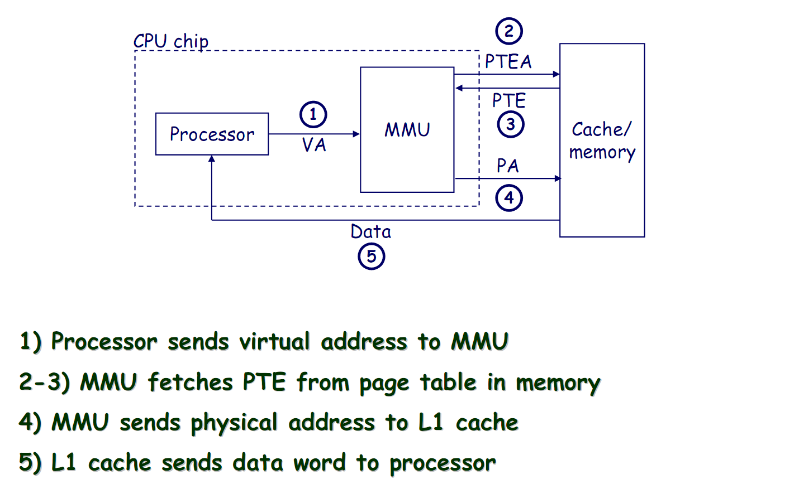
Address Translation: Page Hit

Slide 104
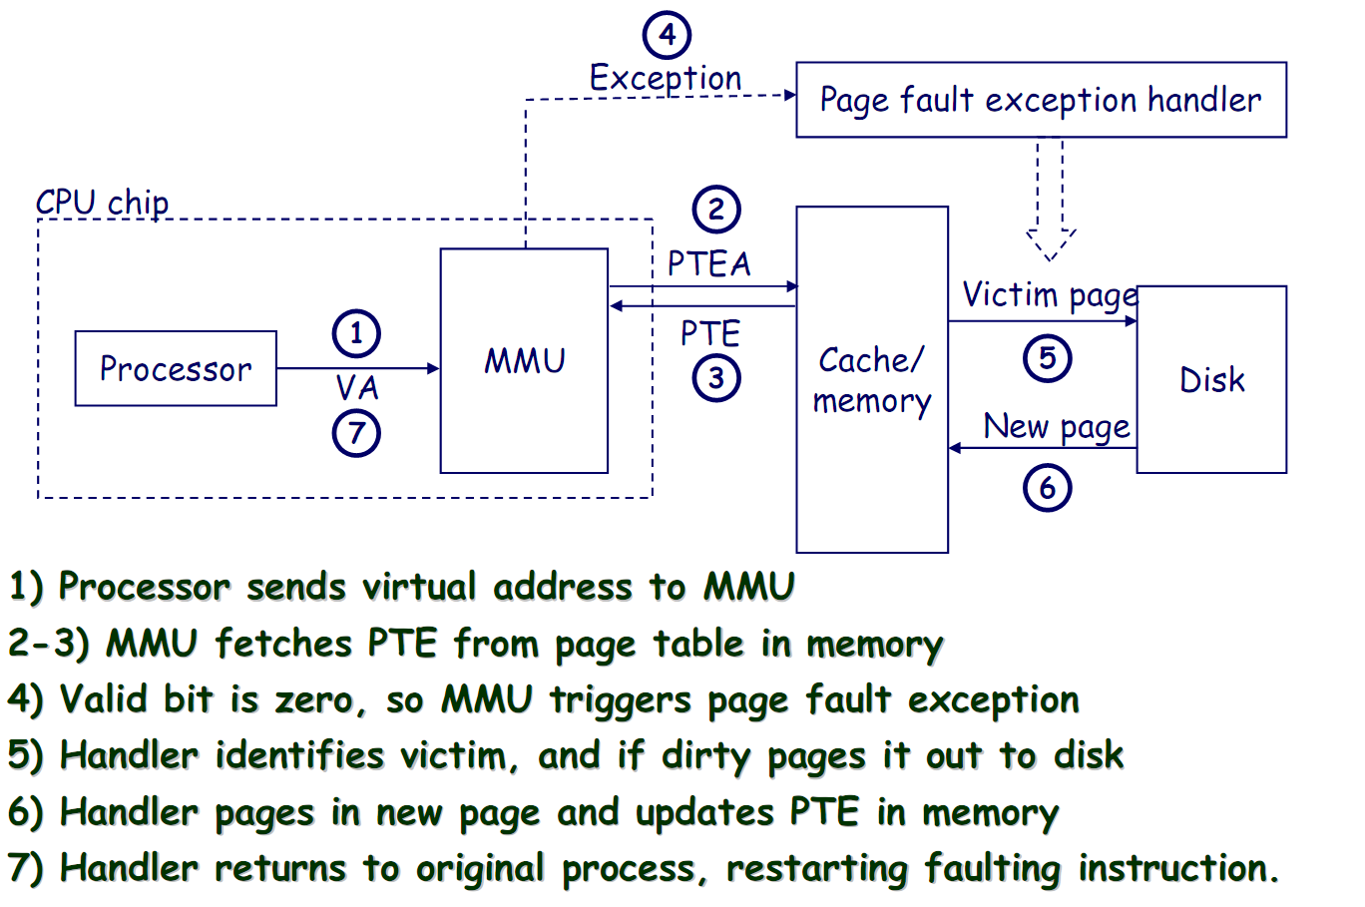
Address Translation: Page Fault

Slide 105
Page Replacement Algorithms
If physical memory is full (i.e., list of free physical pages is empty), which physical frame to replace on a page fault?
Is True LRU feasible?
4GB memory, 4KB pages, how many possibilities of ordering?
Modern systems use approximations of LRU
E.g., the CLOCK algorithm
And, more sophisticated algorithms to take into account “frequency” of use
E.g., the ARC algorithm
Megiddo and Modha, “ARC: A Self-Tuning, Low Overhead Replacement Cache,” FAST 2003.

Slide 106
A System Using Virtual Addressing
Physical (main) memory
0:
CPU Chip
1:
Virtual address
(VA)
Physical address
(PA)
2:
CPU
MMU
3:
4
4:
4100
5:
6:
7:
8:
...
M-1:
Data word
Used in all modern servers, laptops, and smart phones
One of the great ideas in computer science
Keywords: Address Translation, Memory Management Unit
Notes:
MMU provides virtualized view of Physical Memory..It intercepts the request from CPU..
The task of converting a virtual address to a physical one is known as address translation
Dedicated hardware on the CPU chip called the memory management unit (MMU) translates virtual addresses on the fly, using a lookup table stored in main memory whose contents are managed by the operating system

